Slide 1
Gene-environment Interactions: Part 1: Basic Concepts and GWIS
Jim Gauderman
Division of Biostatistics
Department of Population and Public Health Sciences
University of Southern California
JimG@usc.edu

Slide 2
Overview
Basic concepts of GxE interaction
Candidate gene and GWIS
Power and sample size
Software for GWIS
Incorporating omics

Slide 3
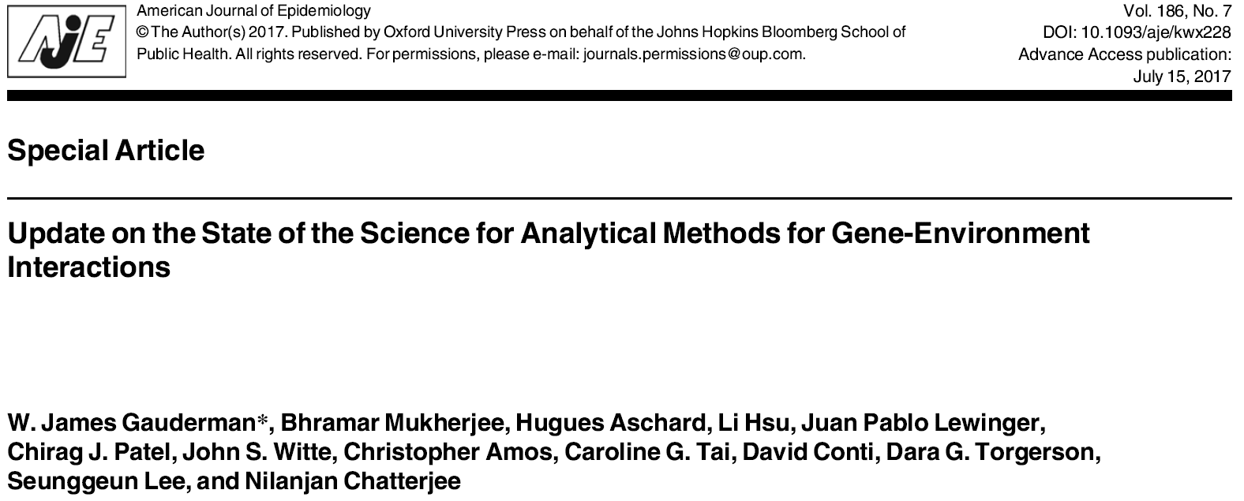
One of a multi-part series of papers on GxE interactions in the same issue

Slide 4
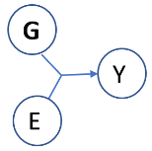
Reasons to Consider GxE
We want to understand something about etiology or underlying biology
e.g. Environmental exposures and genes in the oxidative stress pathway
We want to build better prognostic models
e.g. Use genotype to inform choice of treatment or dietary recommendations

Slide 5
Reasons to Consider GxE
G is important and we want to identify possible higher-penetrance subgroups
Is the BRCA1 → Breast Cancer association stronger in pre-menopausal women?
E is important and we want to identify potentially susceptible subgroups
Is the Air Pollution → Asthma association stronger in those with GSTM1 null genotype?

Slide 6
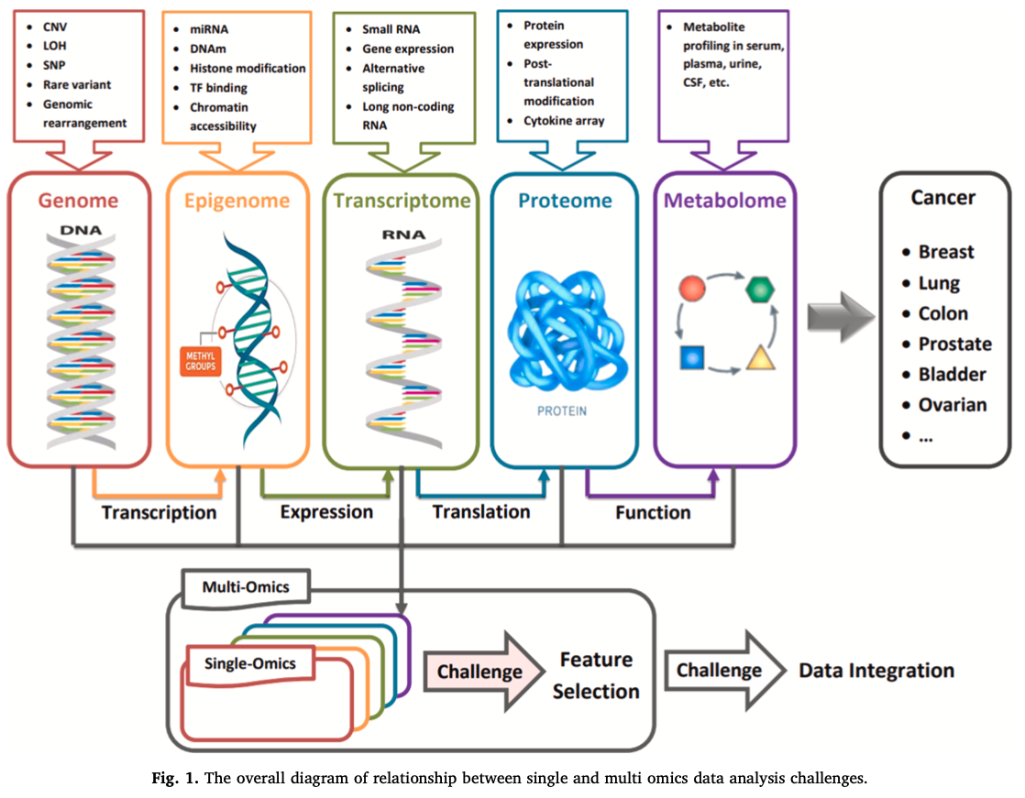
Environment (E) + Multi-omics (G)
Environment
Air pollution
Water pollution
Smoking
Alcohol
Diet
Physical activity
PFAS
etc…

Slide 7
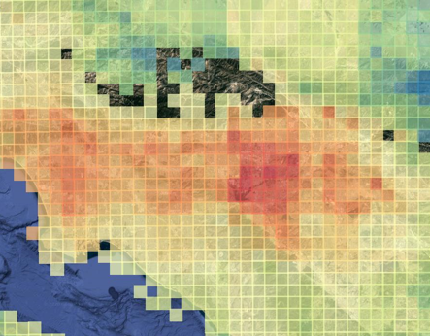

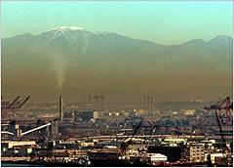
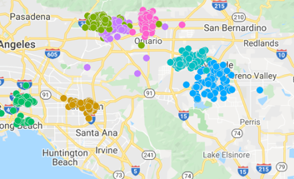
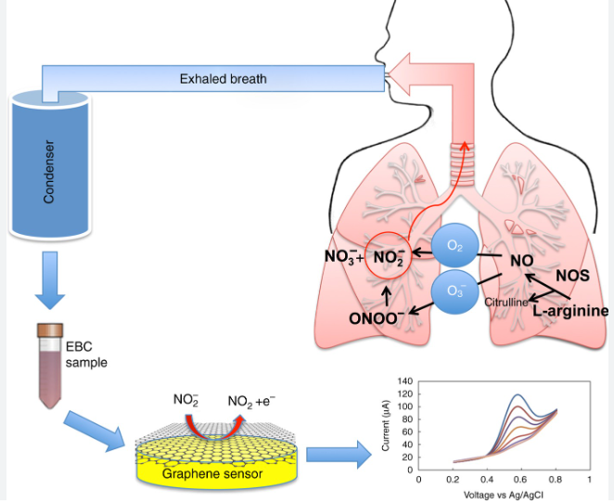
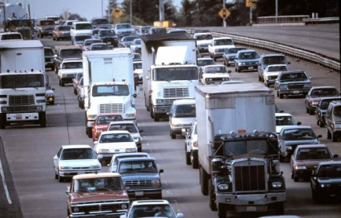

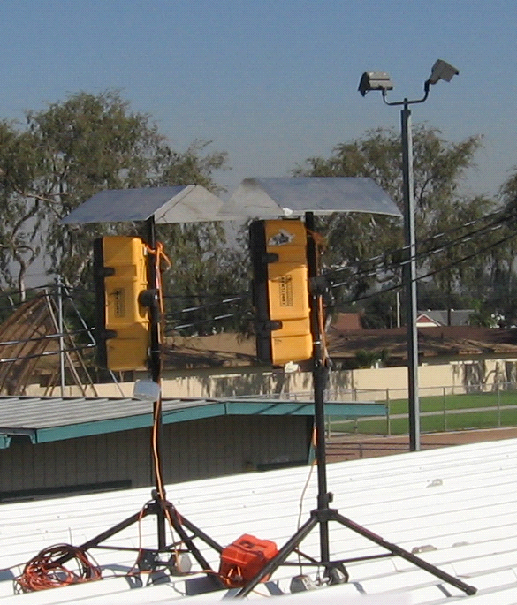
E data: Levels of resolution, e.g. air pollution
Questionnaire
Satellite
Regional monitors
Residence location + Traffic emissions
Commute patterns
Exhaled biomarkers
Wearables

Slide 8
Example: OR’s for GSTM1 and in-utero smoke
N=2,750 CHS children

Slide 9
GxE Interaction and Asthma
(Gilliland et al., 2002, AJRCCM)

Slide 10
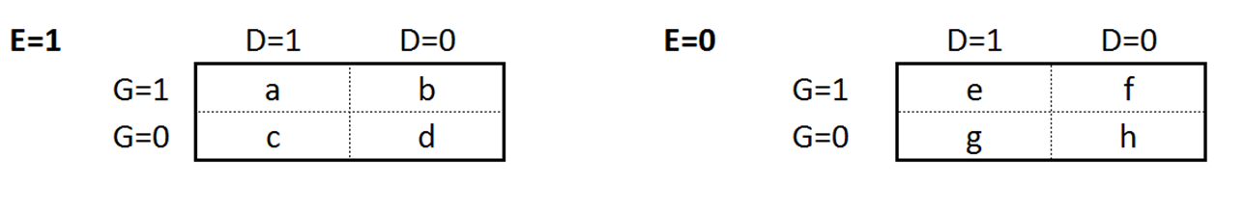
GxE: A Little Math

Slide 11
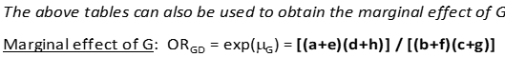
GxE: A Little Math
logit(Pr D=1|G, E) = α + β_{G}G + β_{E}E + β_{GxE}G*E
H₀: β_{GxE} = 0 (standard 1-df test of GxE)
logit(Pr D=1|G, E) = α + μ_{G}G
H₀: μ_{G}=0 (standard 1-df test of G)

Slide 12
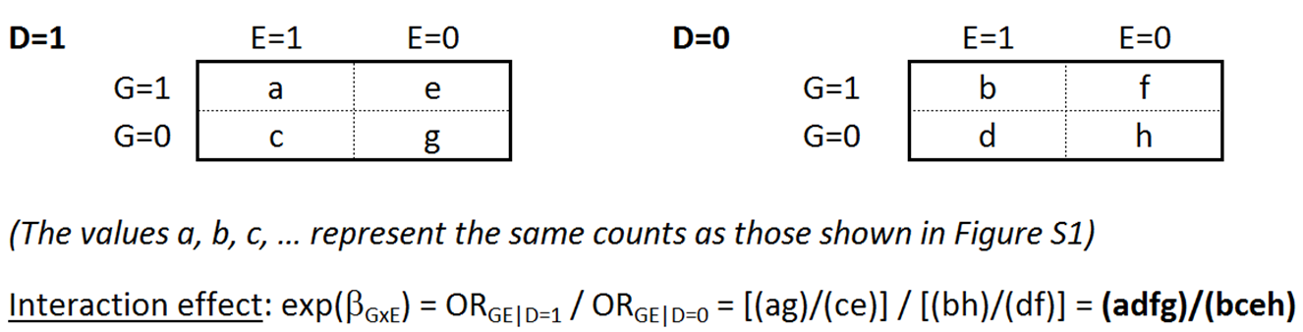
GxE: A Little Math

Slide 13
GxE: A Little Math

Slide 14
GxE: A Little Math
logit(Pr G=1|D, E) = α + β_{D}D + β_{E}E + β_{DxE}D*E
H₀: β_{DxE} = 0 (equivalent to standard 1-df test of β_{GxE})

Slide 15
GxE: A Little Math
(bh)/(fd) ≈ 1.0?

Slide 16
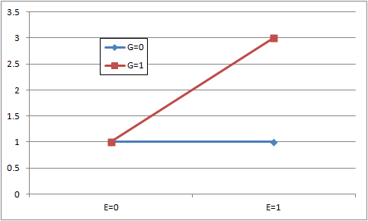
Graphing an Interaction
Odds Ratio

Slide 17
Graphing an Interaction
Required N can be Large
Odds Ratio

Slide 18
Quanto
https://pphs.usc.edu/biostatistics-software/
Gauderman and Morrison
Power and Sample Size Calculations
Several Study Designs

Slide 19
Quanto
https://pphs.usc.edu/biostatistics-software/
Gauderman and Morrison
Several hypotheses

Slide 20
Example: Unmatched case-control (1:1)
Required N (case-control pairs) to detect GxE
80% power, α=0.05, one G

Slide 21
Case-control vs. Case-only Design
Required N to detect GxE (Case-control / Case-only)

Slide 22
Genomewide Association Studies
We want to find this one
How do we do it?
Test disease vs. each marker
Impute each and test vs. outcome
Most GWA studies only test marginal G effects
Causal SNP
…
…

Slide 23
What Are We Missing?
SNPs with modest marginal effect that might be important in one or more subgroups?

Slide 24
What Are We Missing?
SNPs with modest marginal effect that might be important in one or more subgroups?
Size of the marginal G effect depends on prevalence of exposure
Marginal G effect
50% Exposed

Slide 25
What Are We Missing?
SNPs with modest marginal effect that might be important in one or more subgroups?
Size of the marginal G effect depends on prevalence of exposure
Marginal G effect
75% Exposed

Slide 26
What Are We Missing?
SNPs with modest marginal effect that might be important in one or more subgroups?
Size of the marginal G effect depends on prevalence of exposure
Marginal G effect
25% Exposed

Slide 27
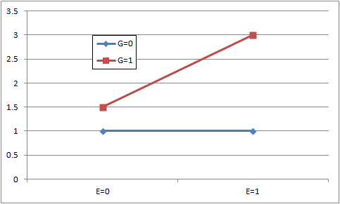
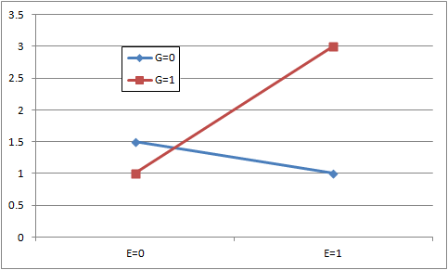
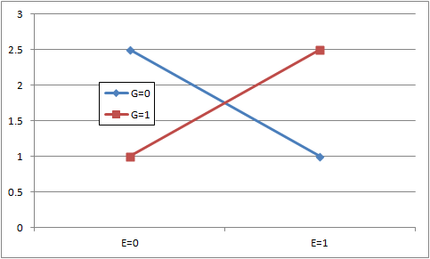
What Are We Missing?
SNPs with modest marginal effect that might be important in one or more subgroups?
SNPs with little or no marginal effect due to opposite effects in subgroups?

Slide 28
Sample size: One GxE vs. a GWIS
Required # case-control pairs α = 0.05 / α = 5×10⁻⁸

Slide 29
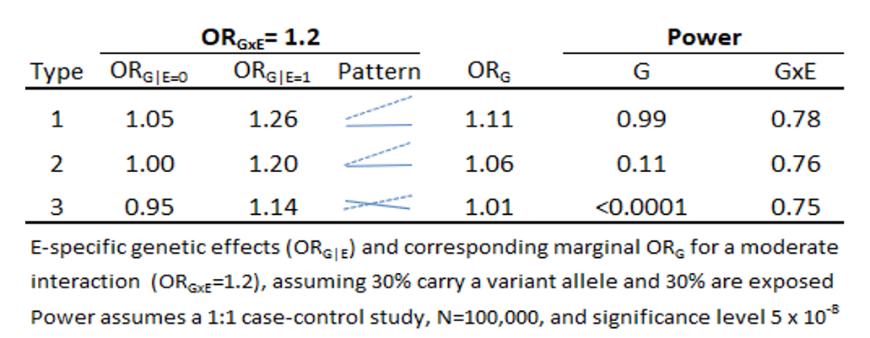
Power to detect a SNP with OR_{GxE}=1.2 in a GWAS and GWIS
(with 3 different patterns of GxE interaction)

Slide 30
Improving GWIS Efficiency: The Basic Idea
For logistic regression of a CC sample:
logit(Pr Y=1|G, E) = α + β_{G}G + β_{E}E + β_{GxE}G*E
the test of H₀:β_{GxE}=0 has low power
There is additional information in a case-control sample about GxE interaction that is not used in the above test

Slide 31
In the Presence of GxE…
Induced “Marginal”:
G to D association
Marginal G effect

Slide 32
In the Presence of GxE…
Induced “Marginal”:
G to D association
G to E association
‘case-only’ style association
Observed in combined case-control sample if cases are oversampled relative to population prevalence
Can we use this extra info to construct more efficient GW interaction scans?
Marginal G effect

Slide 33
2-step Approach: DG|GxE (Kooperberg and LeBlanc, 2008)
Step 1: Genomewide screen of M SNPs using ‘marginal-effect’ test on all subjects
Logit[Pr(D=1 | G) = μ₀ + μ₁G
Test H_{o}: μ₁=0 for each SNP at α_{M} level

Slide 34
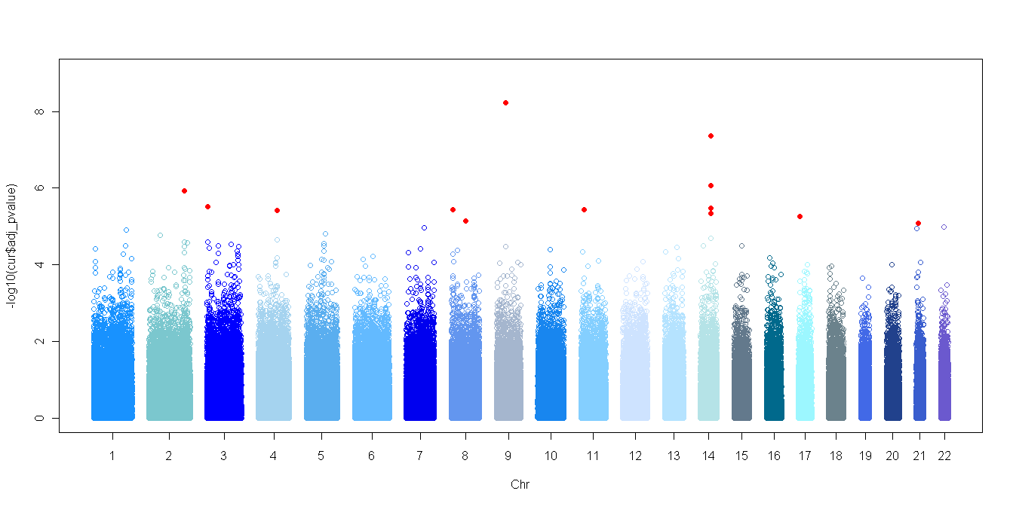
2-step Approach: DG|GxE (Kooperberg and LeBlanc, 2008)
Step 1: Genomewide screen of M SNPs using ‘marginal-effect’ test on all subjects
Logit[Pr(D=1 | G) = μ₀ + μ₁G
Test H_{o}: μ₁=0 for each SNP at α_{M} level
α_{M}

Slide 35
2-step Approach: DG|GxE (Kooperberg and LeBlanc, 2008)
Step 1: Genomewide screen of M SNPs using ‘marginal-effect’ test on all subjects
Logit[Pr(D=1 | G) = μ₀ + μ₁G
Test H_{o}: μ₁=0 for each SNP at α_{M} level
Step 2: For m SNPs with Step-1 p < α_{M} , standard GxE analysis:
Logit[Pr(D=1 | G) = β₀ + β_{G}G + β_{E}E + β_{GxE}GxE
Test H_{o}: β_{GxE}=0 for the m SNPs at α/m level

Slide 36
2-step Approach: EG|GxE (Murcray et al., 2009)
Step 1: Genomewide screen of M SNPs using ‘E vs. G’ test on all subjects
Logit[Pr(E=1 | G) = γ₀ + γ₁G
Test H_{o}: γ₁=0 for each SNP at α_{M} level

Slide 37
2-step Approach: EG|GxE (Murcray et al., 2009)
Step 1: Genomewide screen of M SNPs using ‘G vs. E’ test on all subjects
Logit[Pr(E=1 | G) = γ₀ + γ₁G
Test H_{o}: γ₁=0 for each SNP at α_{M} level
Step 2: For m SNPs with Step-1 p < α_{M} , standard GxE analysis:
Logit[Pr(D=1 | G) = β₀ + β_{G}G + β_{E}E + β_{GxE}GxE
Test H_{o}: β_{GxE}=0 for the m SNPs at α/m level

Slide 38
2-step Approach: EDGE (Gauderman et al., 2013)
Step 1: Genomewide screen of M SNPs using both ‘D vs. G’ and ‘E vs. G’ information
T_{EG} based on E vs G (Murcray et al.)
T_{DG} based on D vs G (Kooperberg & LeBlanc)
→ Screening Test: T_{EgDg} = T_{EG} + T_{DG} (2-df test)

Slide 39
2-step Approach: EDGE (Gauderman et al., 2013)
Step 1: Genomewide screen of M SNPs using both ‘D vs. G’ and ‘E vs. G’ information
T_{EG} based on E vs G (Murcray et al.)
T_{DG} based on D vs G (Kooperberg & LeBlanc)
→ Screening Test: T_{EgDg} = T_{EG} + T_{DG} (2-df test)
Step 2: For m SNPs with Step-1 p < α_{M} , standard GxE analysis:
Logit[Pr(D=1 | G) = β₀ + β_{G}G + β_{E}E + β_{GxE}GxE
Test H_{o}: β_{GxE}=0 for the m SNPs at α/m level

Slide 40
2-step Approach: EDGE (Gauderman et al., 2013)
Step 1: Genomewide screen of M SNPs using both ‘D vs. G’ and ‘E vs. G’ information
T_{EG} based on E vs G (Murcray et al.)
T_{DG} based on D vs G (Kooperberg & LeBlanc)
→ Screening Test: T_{EgDg} = T_{EG} + T_{DG} (2-df test)
Step 2: For m SNPs with Step-1 p < α_{M} , standard GxE analysis:
Logit[Pr(D=1 | G) = β₀ + β_{G}G + β_{E}E + β_{GxE}GxE
Test H_{o}: β_{GxE}=0 for the m SNPs at α/m level
2-step
“Subset” Testing

Slide 41
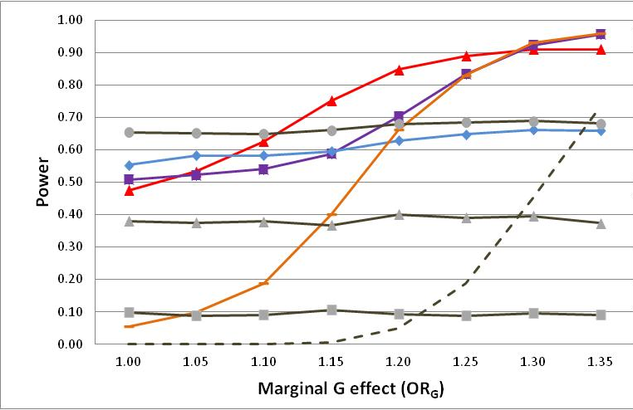
Genomewide Power to Detect OR_{GxE}=1.5 (N=3,500 cases, 3,500 controls)
(Gauderman et al., 2013)
EDGE
EDGE
EG
Case Only
DG
GWAS
GWIS
Notes:
Take home messages for this figure: Power of 2-step methods depend on magnitude of marginal G effect, and there is no universally most powerful method to detect GxE in a GWAS (motivation for implementing multiple methods in GxEscan)

Slide 42
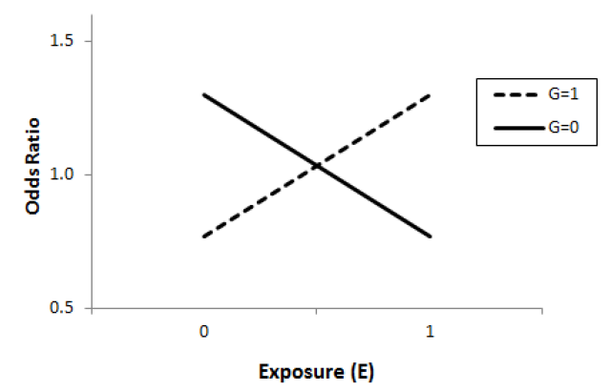
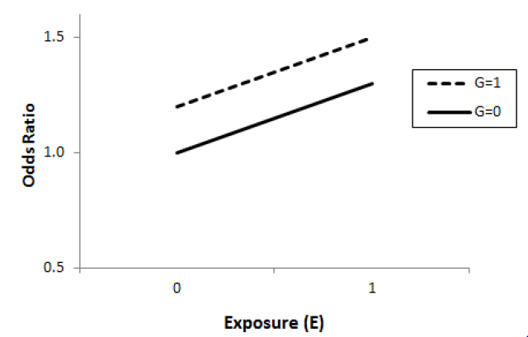
Another way to combine information: The “2-df” joint test
logit(Pr D=1|G, E) = α + β_{G}G + β_{E}E + β_{GxE}G*E
H₀: β_{G} = β_{GxE} = 0 (Joint 2-df test of G, GxE; Kraft et al., 2007)
Can identify loci with …
A GxE effect and induced marginal G effect
A GxE effect but no G effect
A G effect but no GxE effect

Slide 43
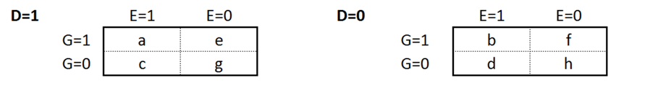
A Joint Model that uses more information
As we have seen, using D-G and E-G information can improve power to detect GxE in a GWIS
What if we treat ‘G’ as the outcome?
β_{D}: G vs. D
β_{E}: G vs. E
β_{DxE}: G vs. DxE (equivalent to D vs. GxE)

Slide 44
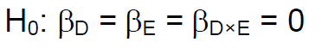
The “3-df” Joint Test
(Gauderman, Kim, Lewinger, Conti, Morrison, Thomas; 2019)
What is it testing?
Marginal G vs. D association (standard GWAS)
Marginal G vs. E association (“case-only” style G x E)
G x E interaction (standard GWIS)
Potentially powerful for discovery

Slide 45
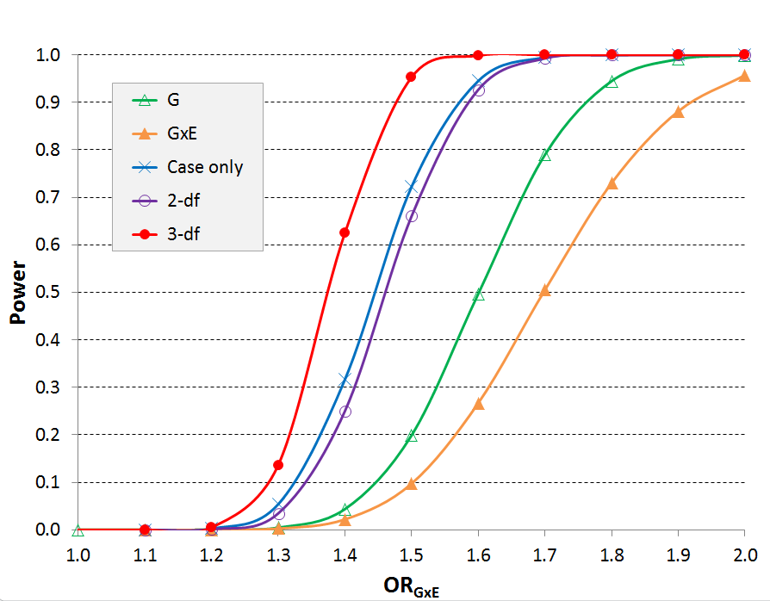
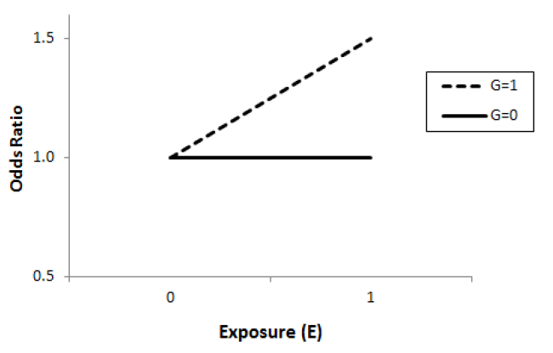
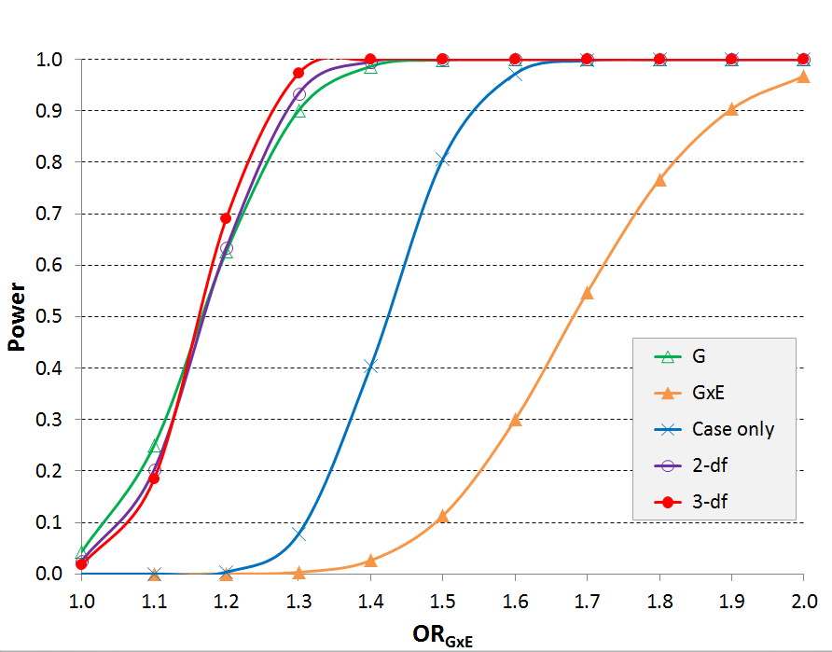
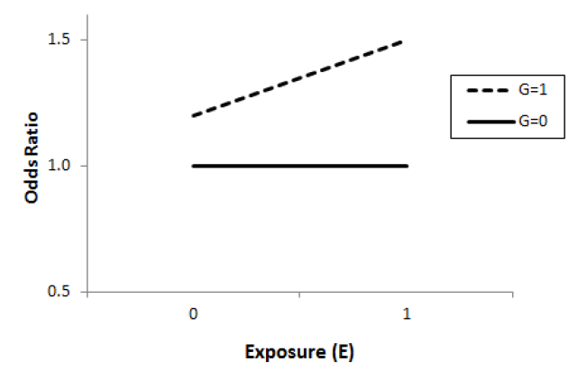
Pure GxE
Quantitative GxE

Slide 46
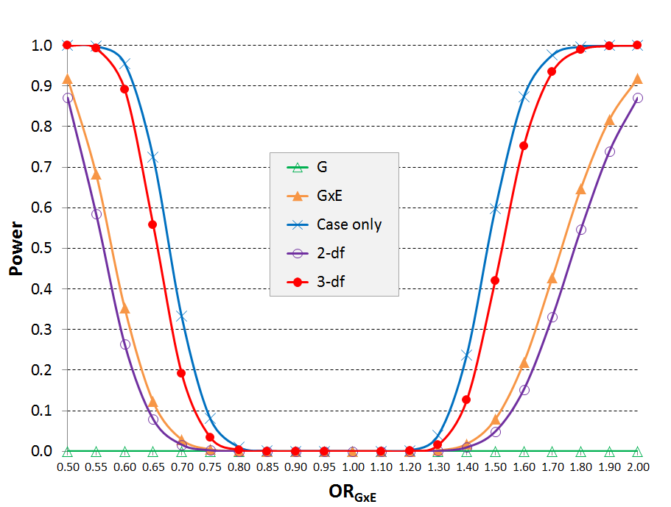
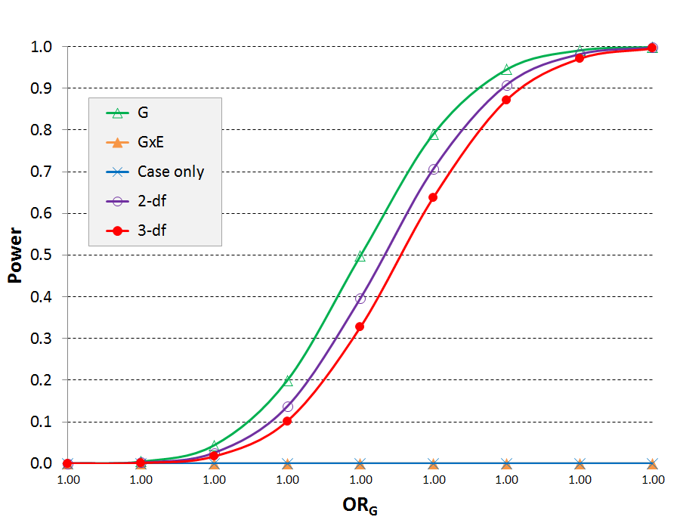
Qualitative GxE
No GxE

Slide 47
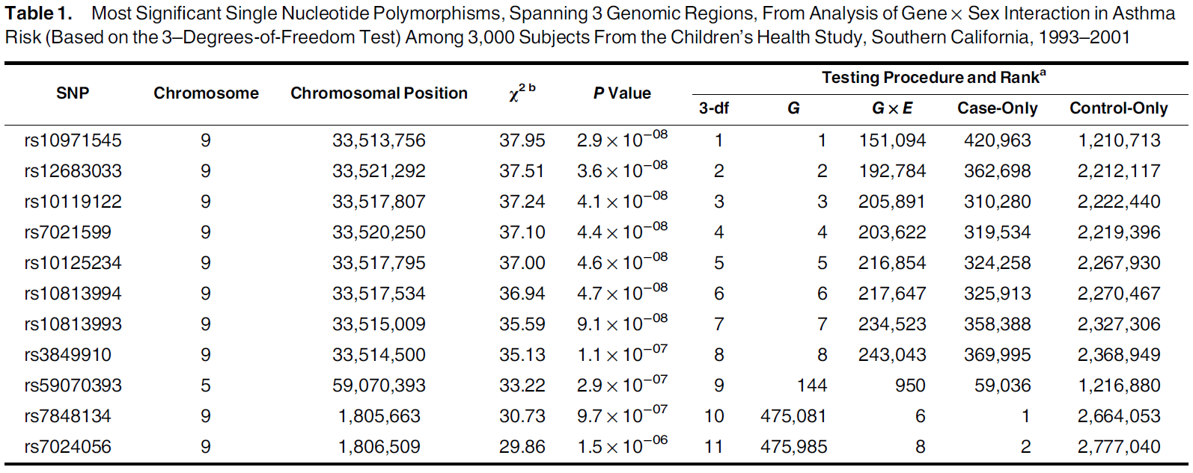
G x Sex interaction scan for asthma in the CHS (1,249 cases, 1751 controls)

Slide 48
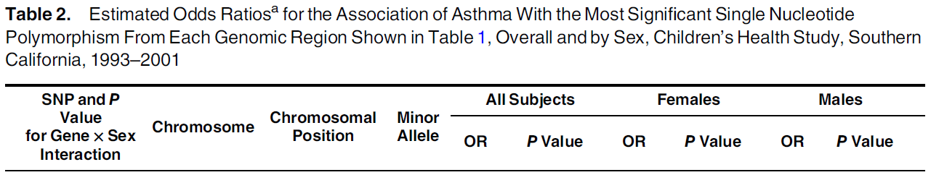
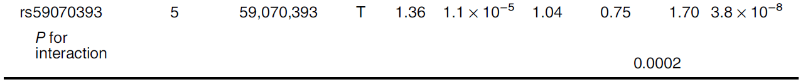
Sex-specific effects: Chr 5 SNP
SNP is in the PDE4D locus, a known asthma gene

Slide 49

BinaryDosage + GxEscanR: Software for GWIS
(Morrison, Gauderman: on CRAN)
Measured or Imputed Genotypes (.GEN or .VCF)
(BinaryDosage)
Phenotype (quantitative or disease) and covariates, including ‘E’ (.txt)
GxEscanR
G Only
2-df G, GxE
Disease
Trait
GxE
Case only
E vs. G
3-df
Standard G, GxE, 2-step, joint tests
Notes:
Workhorse driving GWIS
Mention runtimes for GWIS

Slide 50
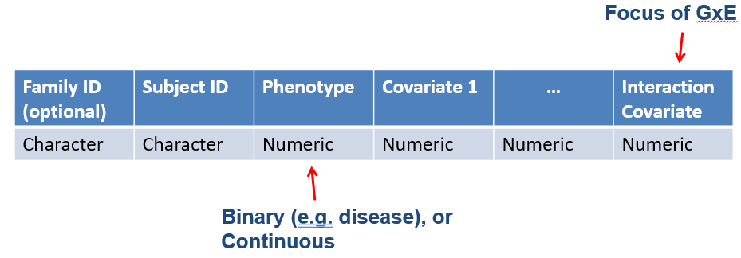
Input Data
Subject Data Format:
Genotype Data: Pre-process using BinaryDosage
Reads raw genotype data and creates binary file for fast downstream analysis
Handy utilities for descriptive summaries (e.g. getmaf)

Slide 51

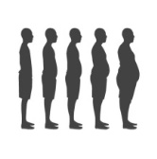


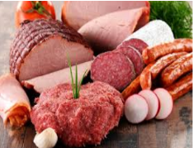

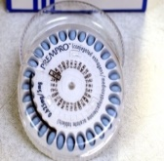


FIGI: Functionally Informed GxE Peters (UW), Gauderman (USC), Casey (UV), LeMarchand (UH)
N ~55,000 colorectal cancer cases, ~60,000 controls (Y)
“Genetic” data (G):
HRC imputation: >39 million SNPs
“Epi” data (E):
Harmonized individual-level data
“Omics” data (X):
Gene expression from normal colon tissue (n=445) (Diez–Obrero et al., 2021)
Paired (E vs. ~E) colon organoid expression (n=34) (Devall et al., 2021)
Primary goals: Discover novel G×E & omic × E interactions for CRC

Slide 52
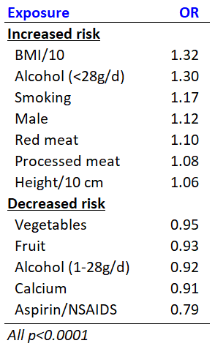
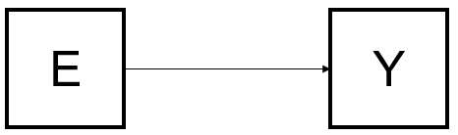
Starting Simple: E Risk factors for CRC in FIGI Study

Slide 53
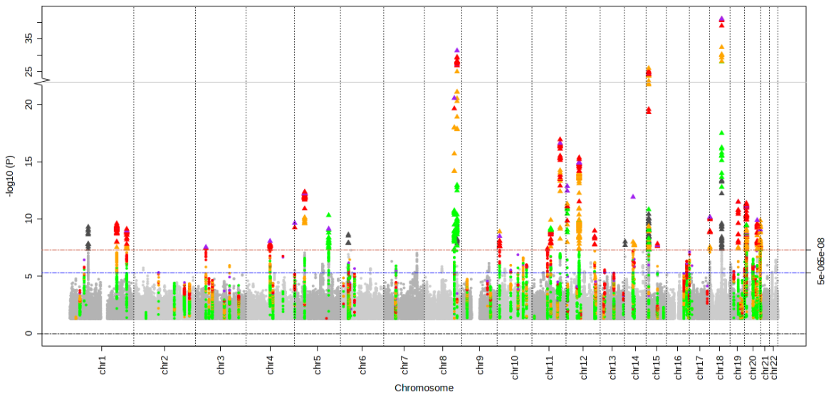
Association Analysis with Omics
Single omic layer measured on a set of individuals
E.g. Genomewide SNPs vs. Cancer (GWAS) in FIGI Study
E[f(Y)] = α + β_{G}G_{j} j = 1,…,M
Y
G
>200 SNPs associated with CRC

Slide 54
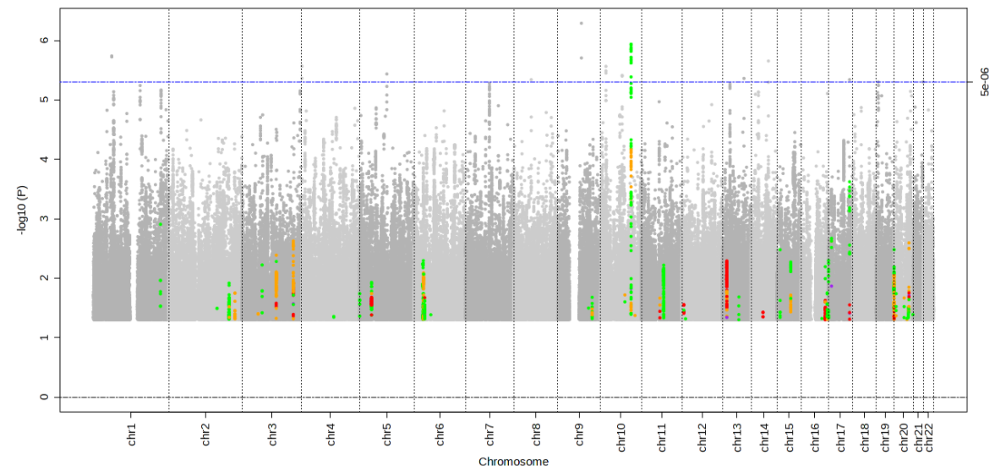
Joint E and Genomic effects
How do G, E and GxE affect a cancer outcome Y (GWIS)?
E[f(Y)] = α + β_{E}E + β_{G}G_{j} + β_{GxE}G_{j}xE
Low power: e.g. G×Alcohol → CRC
More powerful 2-step methods?
E
Y
G
No SNPs with GxE significant at 5 x 10⁻⁸

Slide 55
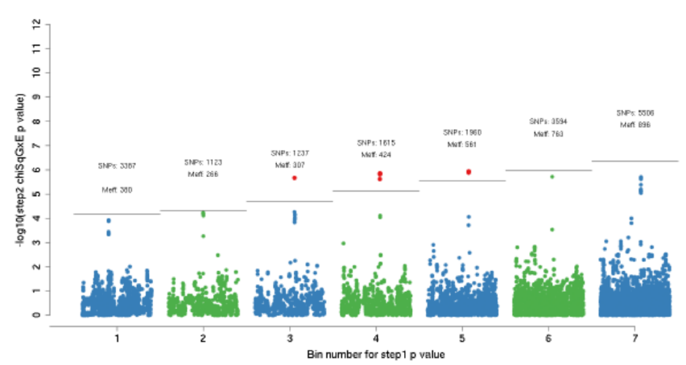
2-step GxE methods
Step 1
EDGE method to rank SNPS by likelihood of being involved in GxE
Step 2
Option 1: Subset testing (as described above)
Option 2 (more powerful): Rank by Step 1 p-value and place into ‘bins’…then test GxE with
bin-specific significance level
(Kawaguchi et al., 2022)
e.g. 2-step G×Alcohol → CRC
GxEScanR package
Significant hits on Chr 10 near
Cox15 and ENTPD7 genes
(Jordahl et al., 2022)

Slide 56
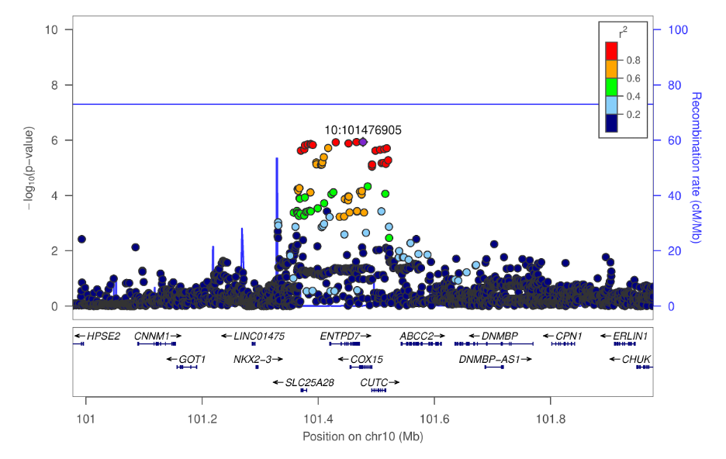
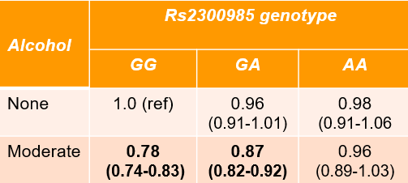
GWIS scan for CRC: G x alcohol
Overall 2-step p-values < 5 x 10⁻⁸
(Lewinger et al., in progress)
A protective effect of moderate alcohol consumption:
OR=0.87 for GA genotype
OR=0.78 for GG genotype

Slide 57
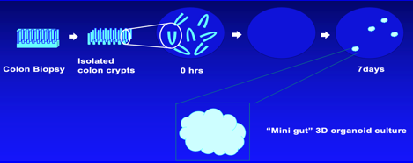
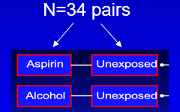
Association of E to Omics
Direct effect of E on some omics layer X
e.g. differential expression by E in organoids (Devall et al., 2021)
E
X
DEGs?

Slide 58
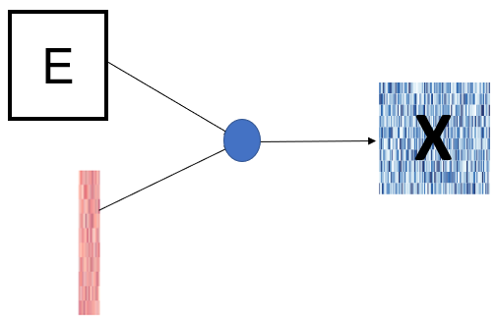
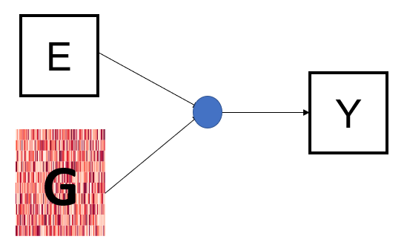
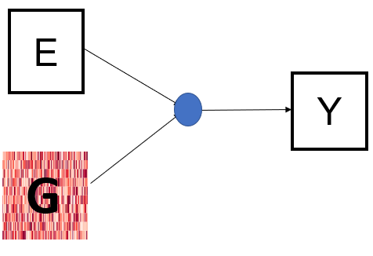
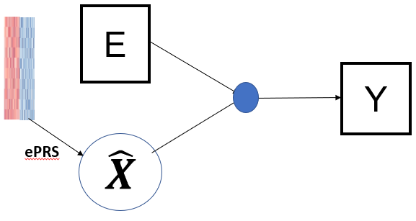
Adding another omics layer
Example: Late Integration of gene expression (X) data
Do SNPs that show G x E→ Y also show G x E→X for some X?
Do SNPs that show G x E → Y also show X x E → Y?
Top Hits
gxeQTL?
(Main data)
(Separate data)
(Main data)
Top-hit regions + Flanking Genes
(Main data)
(Separate data)

Slide 59
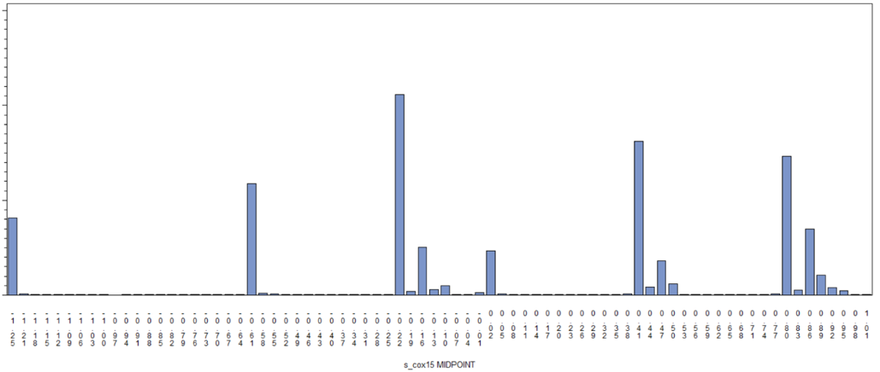


G x Expression using BarcUVa Data
N=445 BarcUVa samples used to generate eQTL models (ePRS) for Cox15 and ENTPD7
Using those models, predict expression ( ) in N ~102,000 FIGI subjects
Does predicted expression interact with alcohol to affect CRC risk?
Cox15
ENTPD7
( – Median)/IQR
( – Median)/IQR

Slide 60

Example: Expression x Alcohol scan (Jorhahl et al., 2022)
Moderate alcohol is protective for those at median of gene expression
Moderate alcohol has greater protective effect with increased gene expression
Notes:
PTGER4 is a important for the biological mechanism of action of aspirin. Unfortunately however, eQTL looks up of this markers (+ LD SNPs Rsq > 0.5) didn’t yield any significant findings. There IS an eQTL in GTEx v8 with PTGER4, but the finding is for “(Skin_Not_Sun_Exposed_Suprapubic)”

Slide 61



Adding another omics layer
Example: Early Integration of gene expression (X) data
Restrict GxE → Y analysis to eQTLs in 1+ relevant cell types
TWIS
(Separate data)
(Main data)

Slide 62

Using E in both stages
Example: gxeQTL analysis followed by TWIS
(separate data) (full data)
→
Requires same ‘E’ in both data sources
gxeQTL?

Slide 63

Adding another omics layer
Example: Joint Integration of gene expression (X) data
More on this in the next GxE Lecture (Juan Pablo Lewinger)

Slide 64



What about E? Using biomarkers as an exposure
IGF-1 is a biomarker related to CRC risk
Not possible to measure in large consortia
PRS-based prediction of IGF-1 (E)
Computable on all subjects
Avoids some potential biases (especially in case-control)
Predictions used in downstream GxE analyses

Slide 65

Table from recent grant application

Slide 66

Predicted IGF-1 in FIGI Samples
IGF1 PRS model development:
Murphy et al. Circulating Levels of Insulin-like Growth Factor 1 and Insulin-like Growth Factor Binding Protein 3 Associate With Risk of Colorectal Cancer Based on Serologic and Mendelian Randomization Analyses. Gastroenterology, 2020, 1300-1312.
Cross-validated R-squared=0.094
413 SNPs, all available in FIGI data
PRS model applied to 89,796 subjects in FIGI study →

Slide 67

GWIS: 1 df test of G x IGF-1

Slide 68

GWIS: 1 df test of G x IGF-1

Slide 69

CRC vs. IGF-1 stratified by Chr 13 SNP (near CDC16)

Slide 70


G x IGF-1: G = Chr 13 SNP or CDC16 expression
SNP x IGF-1
Predicted Expression in FIGI Samples
Expression x IGF-1

Slide 71

Putting it All Together
G × E → Y? (GWIS)
G × E → X? (GWIS, often small N)
X × E → Y? (TWIS, MWIS,…)
G × E → Y (omics to predict E)
Analysis approaches?
Efficient 2-step and/or multi-df tests
Hierarchical models (GxE session part 2)

Slide 72
GxE Lecture 1 Summary
GxE analysis holds promise for discovering novel omic factors
No ‘universally’ most powerful method…
…But statistical power improved using additional information
2-step methods
2-df and 3-df tests
Developed for GWIS but applicable to TWIS, MWIS, …
Pairing methods with software is key…time to practice in LAB #1

